Slide 1
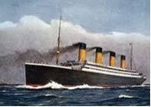
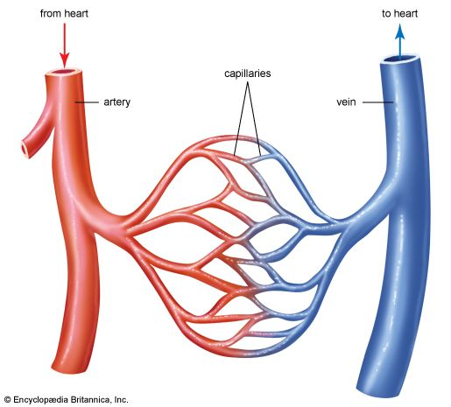
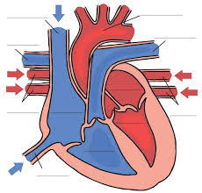
Year 6 Homework Grid
Autumn Term
I like being a mathematician:
Create a bar chart which shows how many men, women and children boarded the Titanic for its maiden voyage. Create a second bar chart to display the number of men, women and children who survived the disaster. Compare the two charts.
Research the price of tickets on board the Titanic for first, second and third class. Work out how much it would have cost for your family to travel in each class section.
Create a poster named “Titanic in Numbers”. Research the number of supplies on board the Titanic (including food, drink, plates, silverware, light bulbs, cups etc). Is anything surprising to you?
I like being creative:
Design a poster advertising the Titanic’s maiden voyage and its trip to New York. You can either draw your poster or design it using technology.
Use junk materials from around your house to design and make a 3d model of the RMS Titanic. Think about how you will create the iconic funnels, and what coloured paint you will use to replicate the Titanic’s colours.
Draw a passenger who might have travelled on the Titanic. Think about what clothes they may have worn, and luggage they may have carried, depending on which class they would have travelled in.
I like being a scientist:
Find out about the size and structure of a human heart and compare it to the size, structure and number of hearts in other animals – worms have five! Display your findings in a poster.
Find out about the different pulse points on the human body, including the side of the neck (carotid), wrist (radial), top of the thigh (femoral) and elbow crease (brachial). Test the different pulse points – which one has the strongest pulse?
Measure your family’s resting heart rates before putting them through their paces. Ask them to hop, skip, jump and run, measuring their heart rates after each activity. Fill in a table with everyone’s results before looking for patterns in the data. Who has the slowest heart rate? Which exercise caused the biggest increase in heart rate?
Key Vocabulary:
Learn the meaning and spellings of:
Pulse
Organs
Blood vessel
Veins and arteries
Nutrients
Vertebrates/ invertebrates
Classification
Species
Taxonomy
Habitat
For your home learning challenge please try to complete at least 2 activities. We look forward to seeing how imaginative your challenges will be.
Please take pride in each piece of work you do and have fun!
You will have a set of spellings to learn each week for a test on Friday– there will be an assignment set on Spelling Shed for you to complete using these words. Please spend time over the week learning your spelling words. You also have a login to Times Table Rockstars, please use this to practise your quick recall of multiplication facts.
Don’t forget to read your book for 10 minutes every day and log your reading on Boom Reader at least 3x per week.

