Slide 1
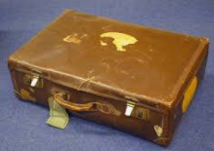
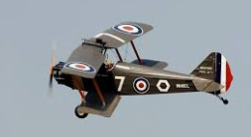
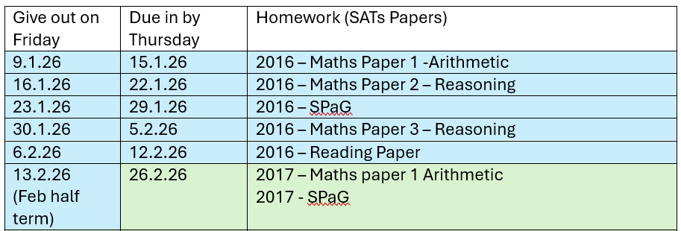
Year 6 Homework Grid
Spring Term
This term, we are going to be learning all about World War 2.
I like being reading, writing and being creative with words:
Keep a diary and record things that are happening in your life- just like Anne Frank did whilst her and her family were hiding in the Annex. Compare your daily life to hers.
I like being researching:
Talk to friends or family about their wartime or post-war memories or experiences. Write down or record their responses. We would love to hear their memories!
I like being a scientist:
During the war, a lot of food was imported. It came in on ships from other countries and was vulnerable to attack from the German navy. What can you find out about which fruit and vegetables we import by looking at food packaging? Can these fruits and vegetables be grown in Britain? Where are they grown? Display your findings in a poster.
I like to draw and be creative
Research the airplanes which flew and fought during WW2. Can you sketch and label one of these planes?
An important message during the war was ‘Make do and Mend! Can you use something old to create something new?
Key Vocabulary:
Learn the meaning and spellings of: Allies, Allotment, Axis, Conscription, Evacuee, Holocaust, Prejudice, Rationing, Telegram, Warden
SATs preparation homework
As explained during the SATs meeting, every child will receive a pat SATs paper to complete at home each week (please see table of dates and papers). These will be given out on a Friday and need to be brought into school on the following Thursday so we can mark them together. Please ask if you have any questions about this homework.
We will continue with our weekly spelling tests on a Friday – please practise these using the assignments set on EdShed.
Don’t forget to also read your book and log your reading on Boom Reader.
Overview of SATs Homework for Spring 1

